Slide 1
HOTEL MANAGEMENT ONLINE
GIẢNG VIÊN: PHẠM THUẬN THÀNH
MEMBERS:
NGUYỄN THỊ TÀI LINH
NGUYỄN VĂN TIẾN

Slide 2
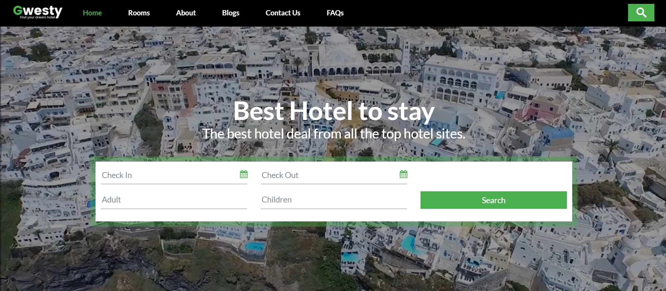
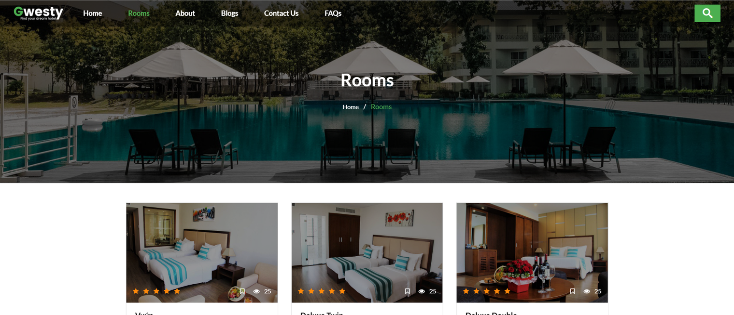
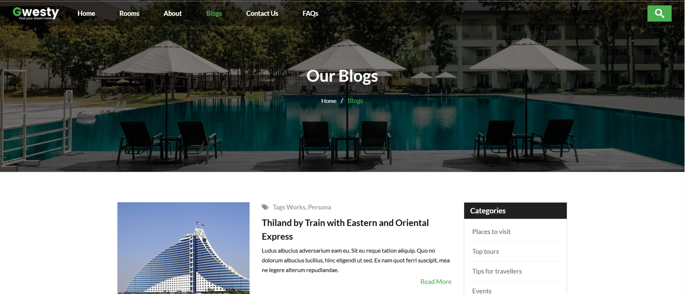
CONTENT
1. PROJECT OVERVIEW
2. TEST PLANNING & EXECUTION
3. SYSTEM DEMONSTRATION
4. CONCLUSION

Slide 3


01. PROJECT INTRODUCTION
01
02
PROJECT OBJECTIVES
PROJECT SCOPE
• Verify all core hotel booking functions.
• Ensure system quality and reliability.
• Detect and report software defects.
• Validate requirements through manual testing.
• Customer Module
• Seller Module
• Administrator Module
• Functional Testing
• Basic Non-functional Testing

Slide 4

SYSTEM ROLES
Customer
Administrator
Search Room
Available room
room detail
Booking
Payment
Cancel Booking
Manage Rooms
Manage Users
Manage Services
Manage Promotions Reports

Slide 5


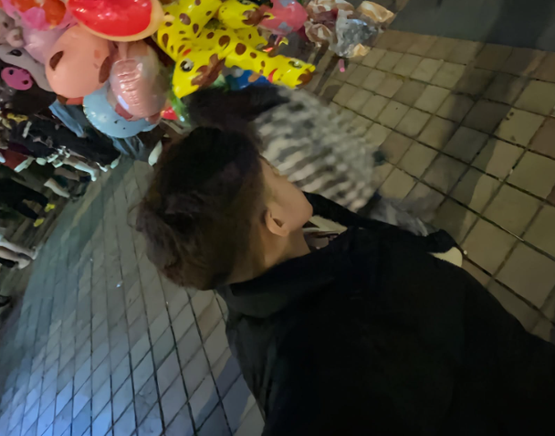
TEAM RESPONSIBILITIES
NGUYỄN THỊ TÀI LINH
• Search Room
• Search Available Room • Payment Processing
• .....
NGUYỄN VĂN TIẾN
• User Management
• Room Type
• Room Management
• ....
NGUYỄN THỊ TÀI LINH
NGUYỄN VĂN TIẾN

Slide 6
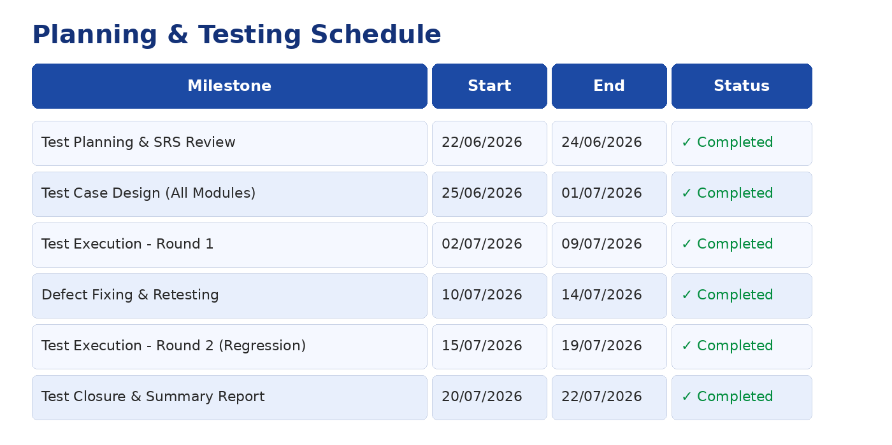
Planning and Testing Methods

Slide 7
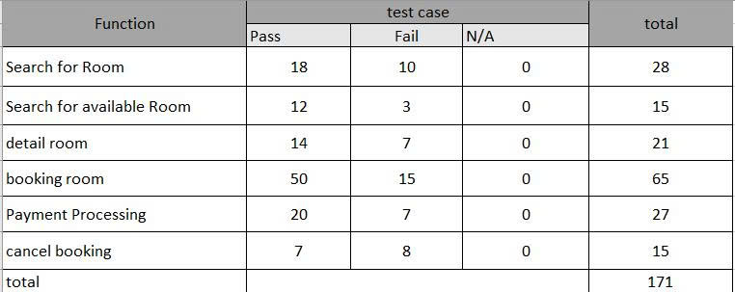
CUSTOMER SIDE/ TEST CASE REPORT

Slide 8
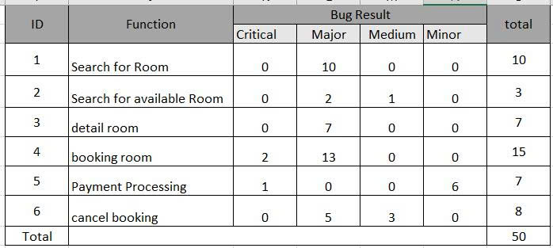
CUSTOMER SIDE/ BUGS REPORT

Slide 9
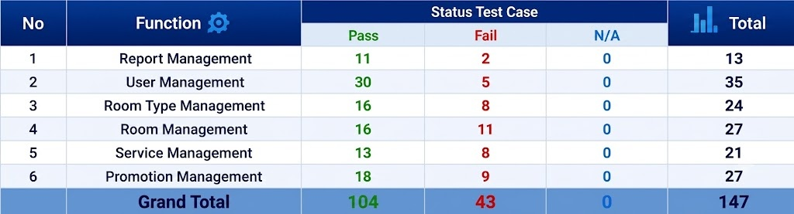
ADMINISTRATION SIDE (ADMIN)/ TEST CASE REPORT

Slide 10
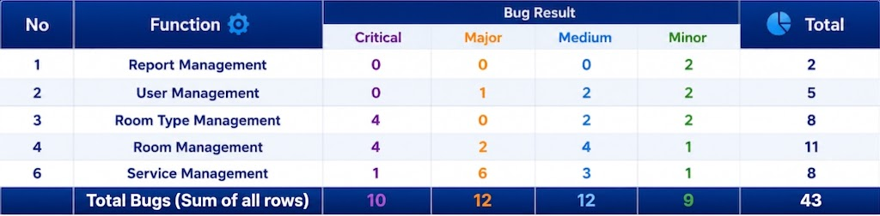
ADMINISTRATION SIDE (ADMIN)/ BUGS REPORT

Slide 11
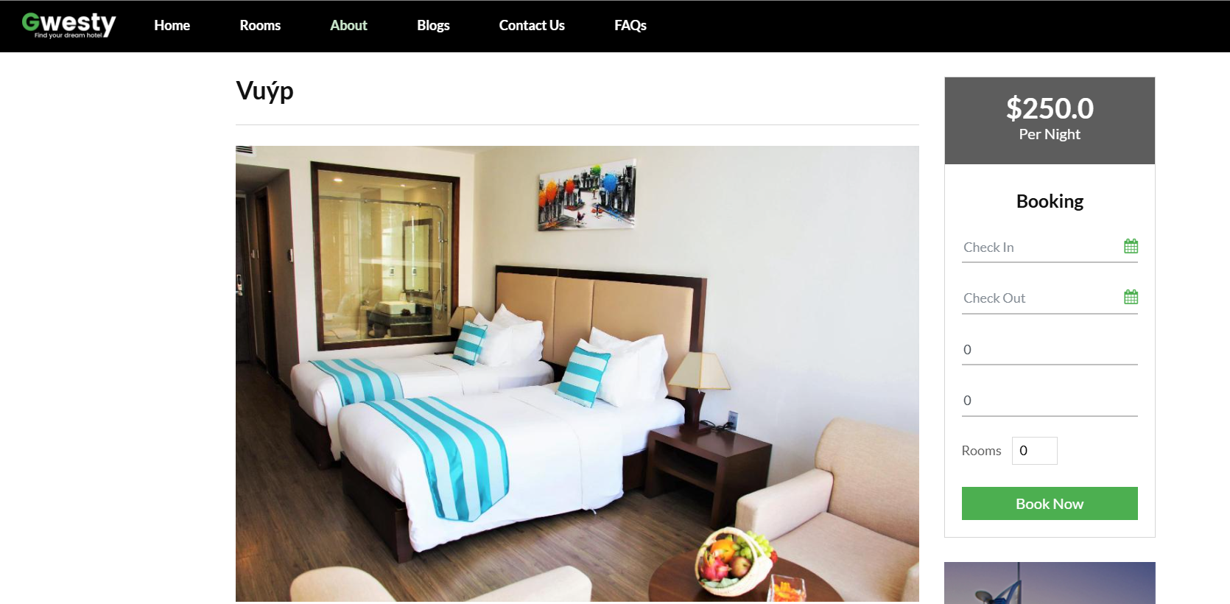
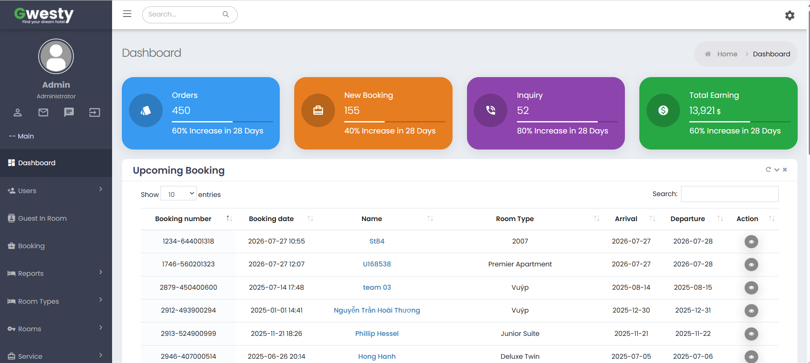

COURSE ST84
SYSTEM DEMO
HOMEPAGE
BOOKING
ADMIN DASHBOARD

Slide 12


PROJECT CONCLUSION
Completed manual testing for all assigned modules.
Detected and documented software defects through Bug Reports.
Enhance system performance, security and automation testing in future development.

Slide 13



LESSONS LEARNED & CHALLENGES
TECHNICAL SKILLS
CHALLENGES
• Improve Test Case Design and Execution.
• Gain practical experience in Bug Reporting.
• Improve software quality through Manual Testing
• Understanding complex SRS documents.
• Designing comprehensive Test Cases.
• Limited project timeline.
• Managing defects during testing.

Slide 14


THANK YOU

